Slide 1
Infrared Luminosity Functions of Galaxies and AGN
A Presentation
Daniel Lyon
Queensland University of Technology
Mount Stromlo Student Seminars, September 2024
Luminosity Functions
1 / 12
Notes:
Hi everyone, my name’s Daniel and I’m a master’s student from Queensland University of Technology. Today I’m giving a presentation on the work I’ve been doing over the past year. I’ve been busying analysing the infrared luminosity function of high-redshift galaxies and AGN.

Slide 2
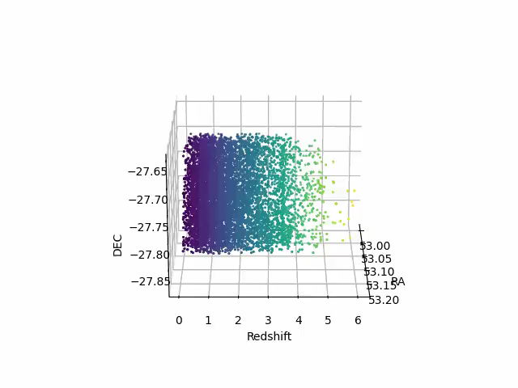
Background: Galaxy Evolution
Distribution of galaxies constrains their evolution
Measure distribution with the luminosity function (LF)
LFs describe the spatial density and quantify their evolution across all time
Figure 1: 3D view of the ZFOURGE CDFS field.
Luminosity Functions
2 / 12
Notes:
So, to start us off, I’m going to give a little motivation about why luminosity functions are important in the context of galaxy evolution.
The simple distribution of galaxies and their luminosities has previously derived powerful constraints on galaxy evolution. One of the direct ways of measuring the distribution of galaxies is with the luminosity function. Luminosity functions (LF) are statistical distributions that describe the spatial density of astronomical objects and are a fundamental tool for quantifying evolution across cosmic time scales. The use of LFs in galaxy evolution studies has uncovered a wealth of information revealing the intricate processes governing star formation, galaxy mergers, and the growth of supermassive black holes.

Slide 3
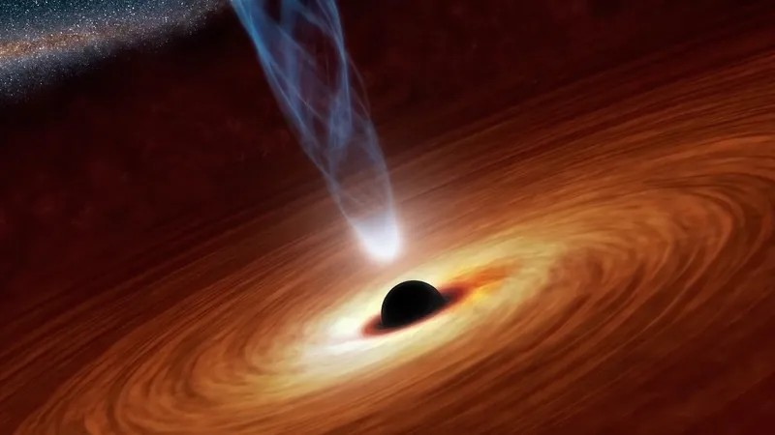
Background: AGN and Star-formation
Correlation between SFR and AGN activity
Gas powers both AGN and SF; inherently linked
Does AGN activity enhance or diminish SF?
Figure 2: Artist’s impression of an active galactic nuclei
Luminosity Functions
3 / 12
Notes:
Many studies of galaxy evolution find a strong correlation between the activity of the central SMBH and the star formation rate. Active Galactic Nuclei (AGN) are actively accreting SMBHs, whereby massive quantities of gas and dust power their growth. SF in galaxies similarly requires an extensive reservoir of cool gas to operate. SFR and AGN activity are therefore inherently linked as the same interstellar material required for SF also powers AGN growth. This connection has fuelled an ongoing debate over whether AGN activity enhances star formation by triggering gas inflows or diminishes it through feedback mechanisms that deplete gas reservoirs. AGN have long been thought to play a crucial role in the evolution of their host galaxy, and there is an abundance of research that supports and challenges this idea. However, exactly how AGN activity impacts galaxy evolution and the complex interplay between the processes regulating SF is poorly understood.

Slide 4
Background: AGN and Star-formation
Correlation between SFR and AGN activity
Gas powers both AGN and SF; inherently linked
Does AGN activity enhance or diminish SF?
Figure 2: Artist’s impression of an active galactic nuclei
Answer: It’s poorly understood
Luminosity Functions
4 / 12
Notes:
Many studies of galaxy evolution find a strong correlation between the activity of the central SMBH and the star formation rate. Active Galactic Nuclei (AGN) are actively accreting SMBHs, whereby massive quantities of gas and dust power their growth. SF in galaxies similarly requires an extensive reservoir of cool gas to operate. SFR and AGN activity are therefore inherently linked as the same interstellar material required for SF also powers AGN growth. This connection has fuelled an ongoing debate over whether AGN activity enhances star formation by triggering gas inflows or diminishes it through feedback mechanisms that deplete gas reservoirs. AGN have long been thought to play a crucial role in the evolution of their host galaxy, and there is an abundance of research that supports and challenges this idea. However, exactly how AGN activity impacts galaxy evolution and the complex interplay between the processes regulating SF is poorly understood.

Slide 5
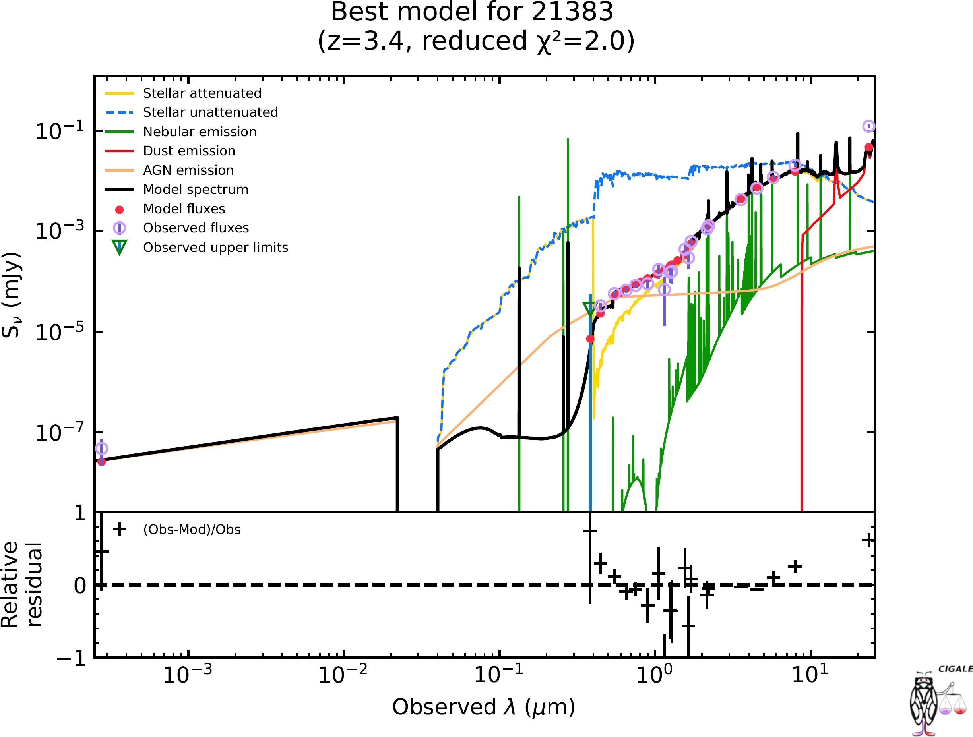
Background: SED Decomposition
SF & AGN are dusty; IR wavelengths are ideal
Extinction absorbs X-ray, optical, and UV and re-emits in IR
Dusty systems crucial to constraining evolution
Distinguishing between AGN and SF is very hard
Figure 3: Example SED decomposed using CIGALE
Luminosity Functions
4 / 12
Notes:
The properties of Infrared (IR) light make it the ideal regime for studying SF and AGN LFs as both processes are often dusty and obscured. Dust extinction absorbs the outgoing X-ray, optical, and UV wavelengths and re-emits the radiation in the IR domain. The population of obscured, dusty IR AGN and SFGs play a crucial role in constraining galaxy evolution models. Since SF and AGN activity are so tightly coupled, distinguishing between the two components can be challenging. We use CIGALE to decompose the IR Spectral Energy Distribution (SED) of ZFOURGE galaxies to generate and analyse both the SF and AGN LFs.
I won’t delve deep into exactly how CIGALE was used to separate the AGN and SF components. That work was mostly done by another student who has since graduated and moved on.

Slide 6
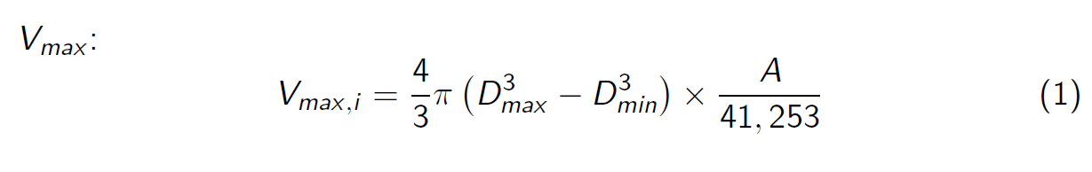
Number Density
Vmax :
4
A
41, 253
V
= π D
3 3
max,i
— D ×
(1)
3
max min
Luminosity Functions
5 / 12
Notes:
We use the 1/Vmax method to calculate the number density of galaxies. This method does not make any assumptions or depend on the shape of the LF itself, making this method a very reliable model of the LF.

Slide 7
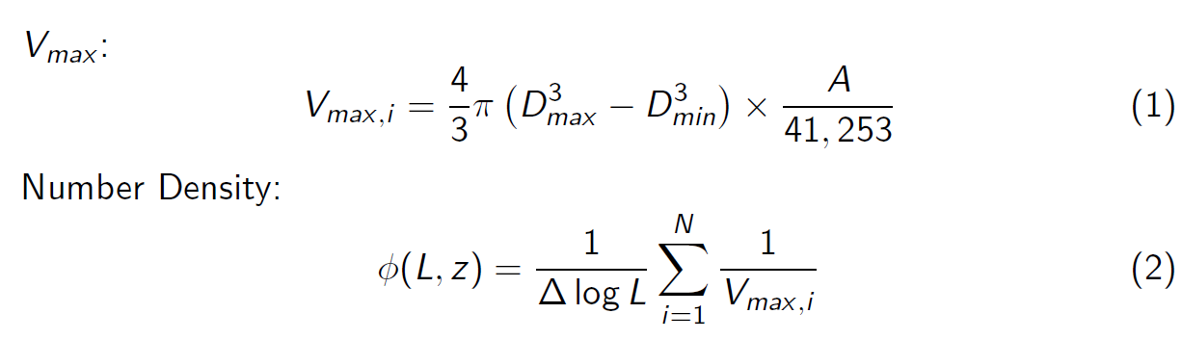
Number Density
Vmax :
4
A
41, 253
V
= π D
3 3
max,i
— D ×
(1)
3
max min
Number Density:
N
Σ
1 1
φ(L, z ) =
(2)
∆ log L
Vmax,i
i =1
Luminosity Functions
5 / 12
Notes:
You can think of number density as simply that. It is the number of galaxies per unit volume. Luminosity functions are split into redshift bins and then again into luminosity bins. This allows us to analyse the evolution of the luminosity function itself throughout cosmic time. Where L is the bolometric infrared luminosity, Dmax and Dmin are the comoving distances of the redshift bin edges that each galaxy resides, and A is simply the area of the sky probed to normalise the LF with the entire sky. The total area probed across the 3 ZFOURGE fields is just 0.1 square degrees, or one 250th of a single percent of the night sky.
So we have our formulas, we have our galaxy luminosity decomposed into their components. Lets make luminosity functions!

Slide 8
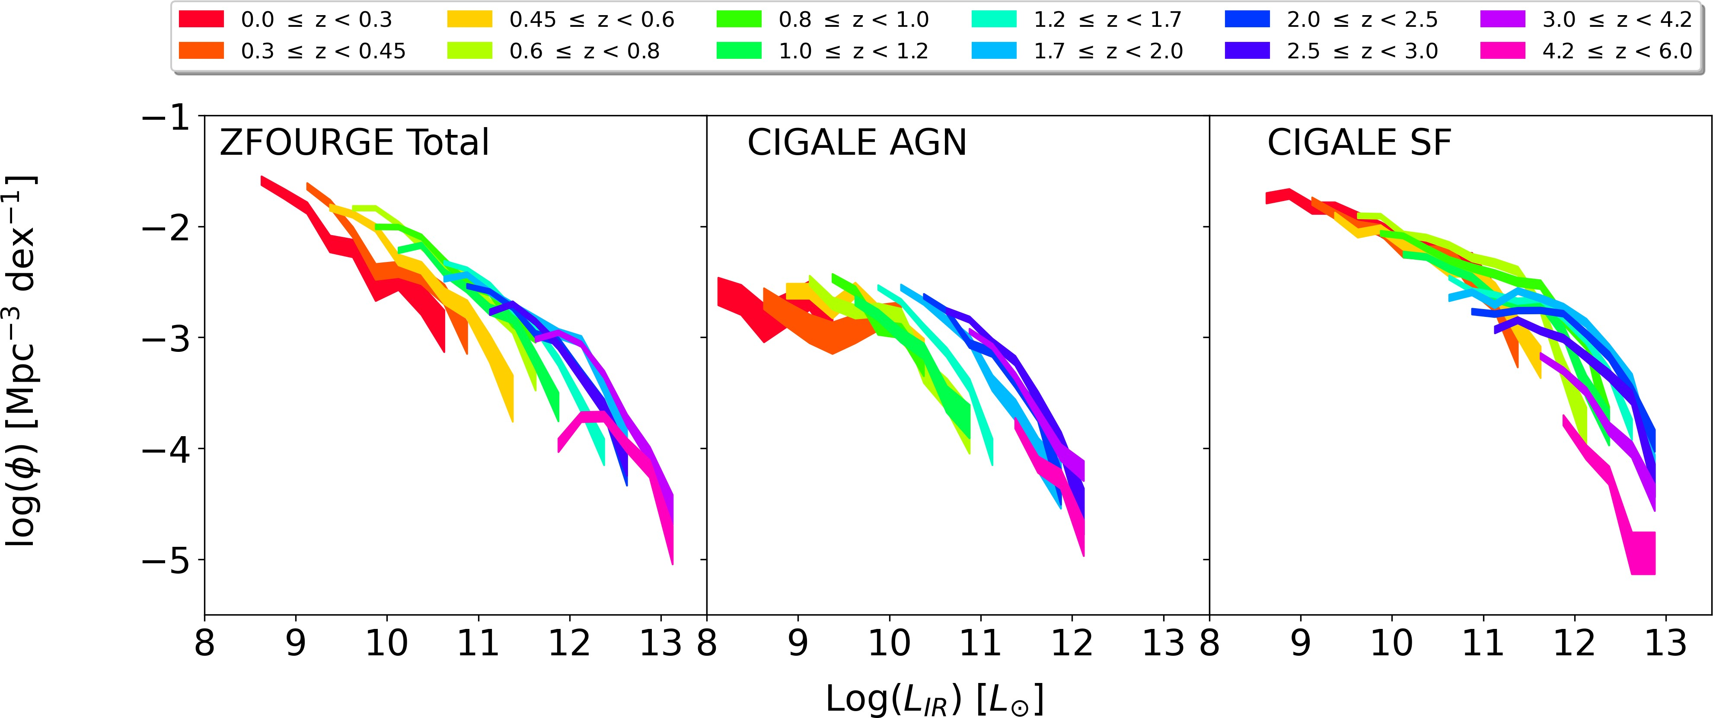
Estimating Luminosity Functions
Figure 4: IR LFs for ZFOURGE total and CIGALE SF & AGN
Luminosity Functions
6 / 12

Slide 9
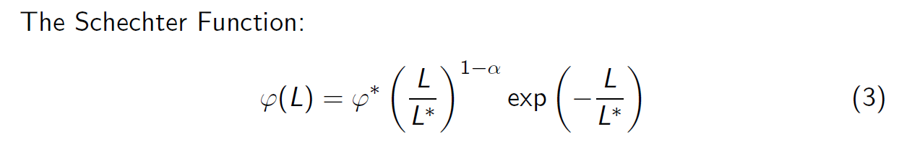
Modelling Luminosity Functions
The Schechter Function:
L _{L}∗
1−α
L
ϕ(L) = ϕ
∗
exp −_{L∗}
(3)
Luminosity Functions
7 / 12

Slide 10
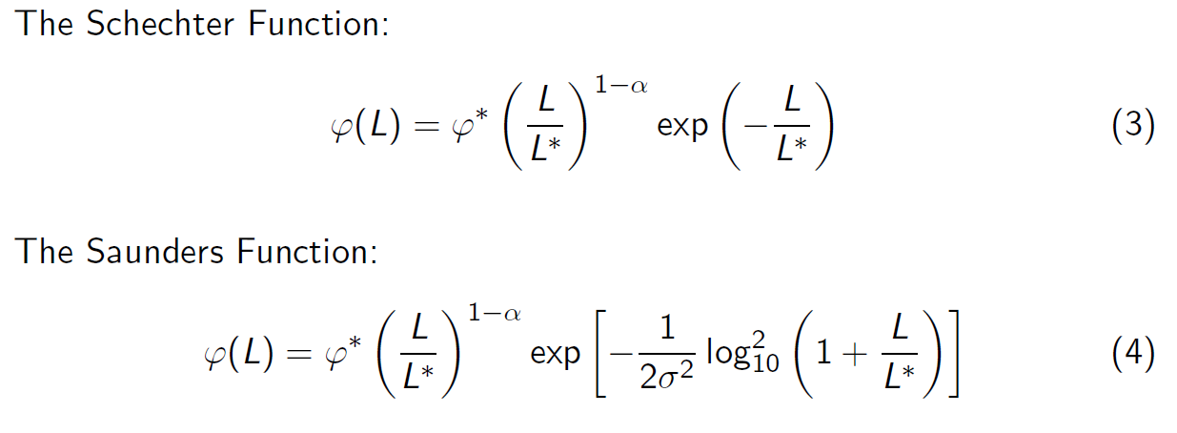
Modelling Luminosity Functions
The Schechter Function:
L _{L}∗
1−α
L
ϕ(L) = ϕ
∗
exp −_{L∗}
(3)
The Saunders Function:
L _{L}∗
1−α
1
L _{L}∗
ϕ(L) = ϕ
∗
2
exp − log 1 +
(4)
2σ²
10
Luminosity Functions
7 / 12

Slide 11
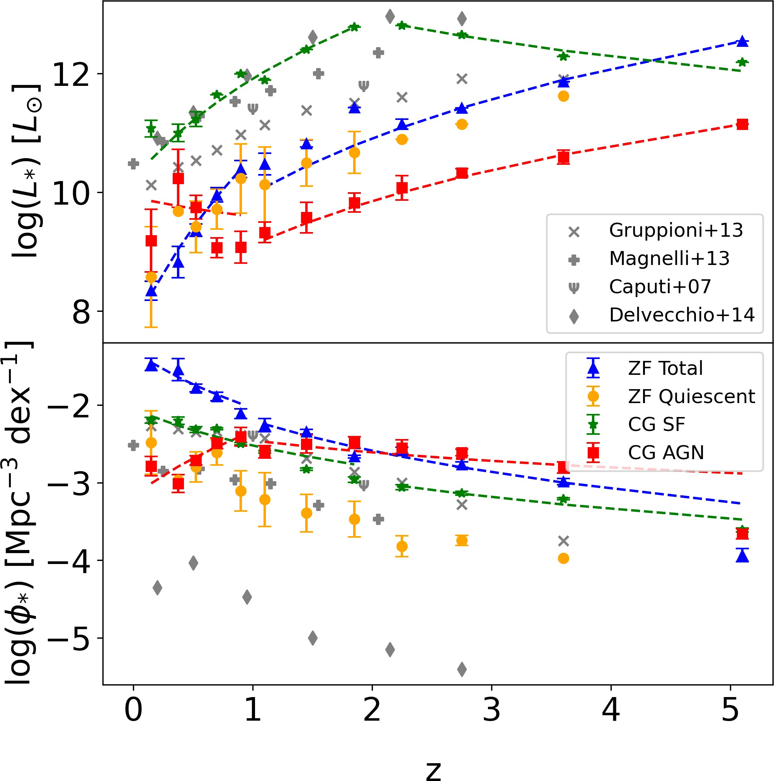
Parameter Evolution
Figure 5: Evolution of L∗ and φ∗
Luminosity Functions
MSSS 2024

Slide 12
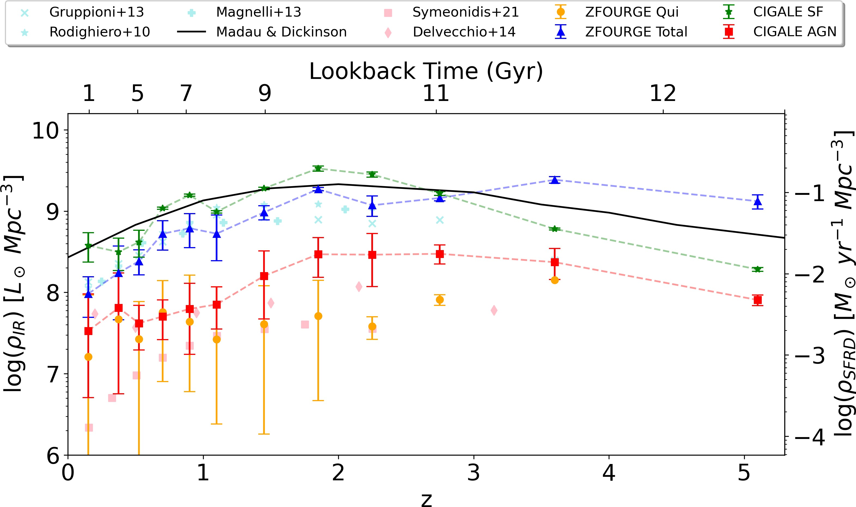
Luminosity Density
Figure 6: Luminosity density of SF and AGN activity
Luminosity Functions
MSSS 2024

Slide 13
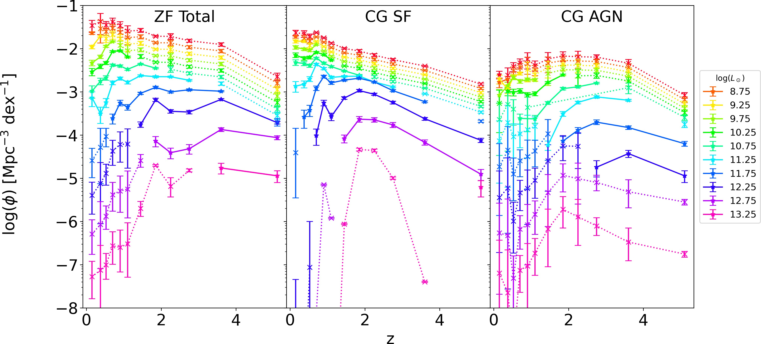
Luminosity Class Evolution
Figure 7: Luminosity class evolution
Luminosity Functions
MSSS 2024

Slide 14
Conclusion
Remark
SED decomposition is required to accurately measure the AGN and SF contribution.
Remark
The gas available for SF is increasingly exhausted at z < 2. AGN activity increases from 0.5 < z < 1 (and might still be increasing!)
Remark
Brighter SFG and AGN become quiescent sooner than their fainter counterparts. AGN “kill” their galaxies much faster than SF.
Luminosity Functions
MSSS 2024

Slide 15

Thank you!
Questions? I’m looking for PhDs!
Figure 8: My website
(Yes, I made my presentation in LAT_{E}X*)
*mostly
Luminosity Functions
MSSS 2024

